Slide 1

QGIS
A Comprehensive Overview of GIS Workflows, Spatial Analysis, and Map Production

Slide 2




GIS Foundations: Data Models
Vector Data
Raster Data
Represents discrete real-world features using precise geometric coordinates.
Represents continuous surfaces as a grid of cells, or pixels.
Structure: Points (cities), Lines (roads), Polygons (boundaries).
Structure: Grid where each pixel holds a numerical value.
Formats: Shapefile (.shp), GeoPackage (.gpkg), KML.
Formats: GeoTIFF (.tif), JPEG.
Scaling: Becomes pixelated (blocky) when zoomed in closely.
Scaling: Remains sharp at any zoom level.

Slide 3
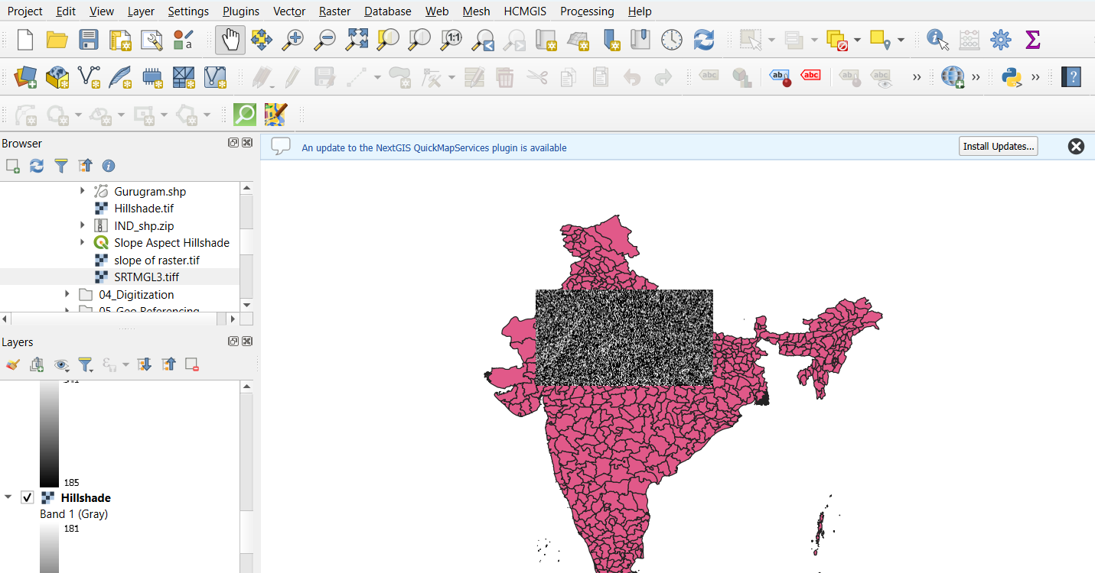

Slide 4
Geographic Context & Basemaps
What are XYZ Tiles? Web-hosted maps loaded in small image squares based on coordinates (X, Y) and zoom level (Z).
Purpose Provides vital geographic background so raw vector data does not float in an empty white canvas.
Implementation in QGIS Connect to OpenStreetMap (OSM) via the Browser panel, or add custom connections like Google Satellite imagery.
Crucial Rule: Layer Order QGIS draws from bottom to top. Basemaps must always be at the very bottom of the Layers Panel stack.

Slide 5
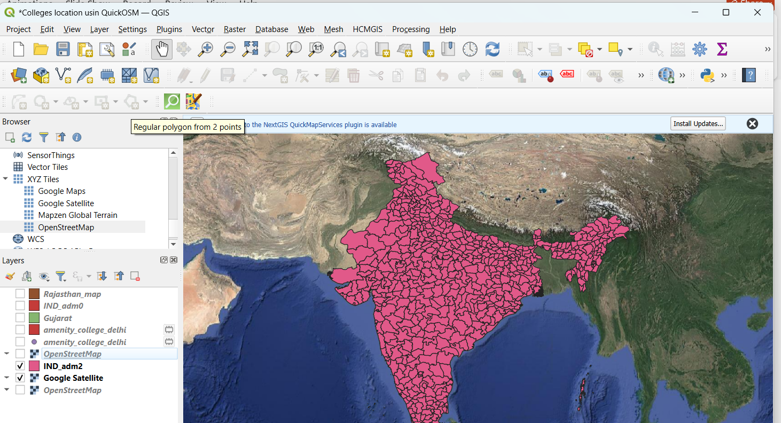

Slide 6
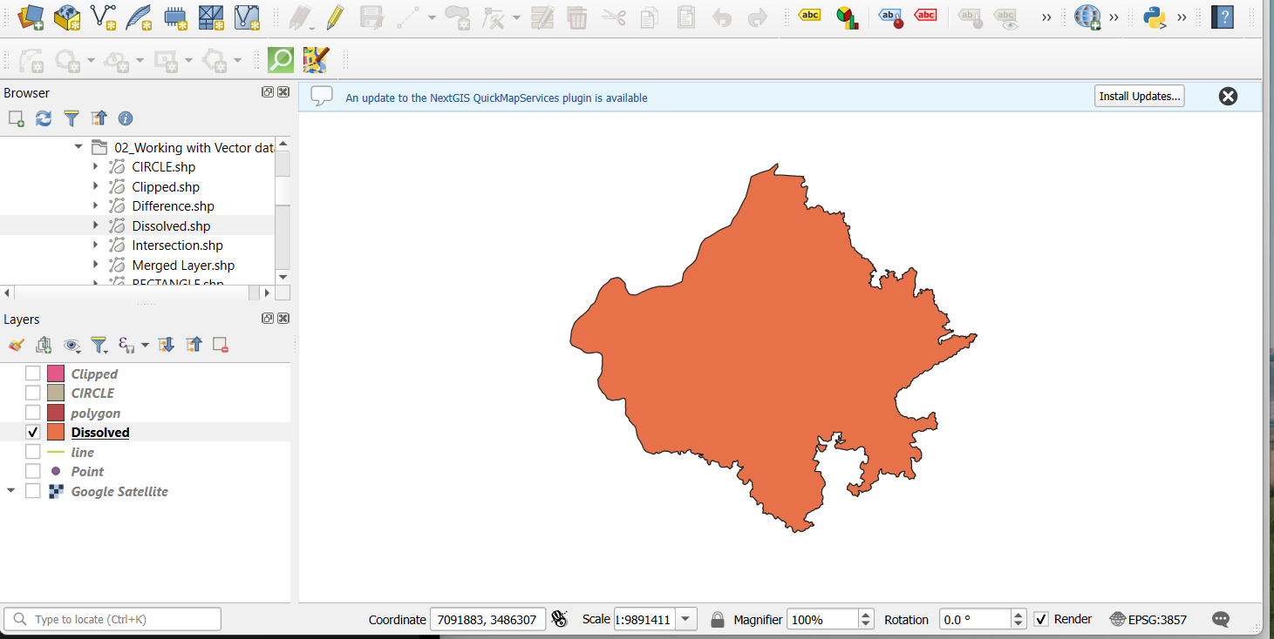

Slide 7






Acquiring Vector Data: QuickOSM
The Function
The Query
The Result
Fetches specific OpenStreetMap vector data directly into the QGIS map canvas instantly, bypassing manual downloads.
Uses Key/Value pairs to search. (e.g., Key: amenity, Value: college) within a specified town or canvas extent.
Instantly generates accurate points and polygons for features without needing external datasets.

Slide 8
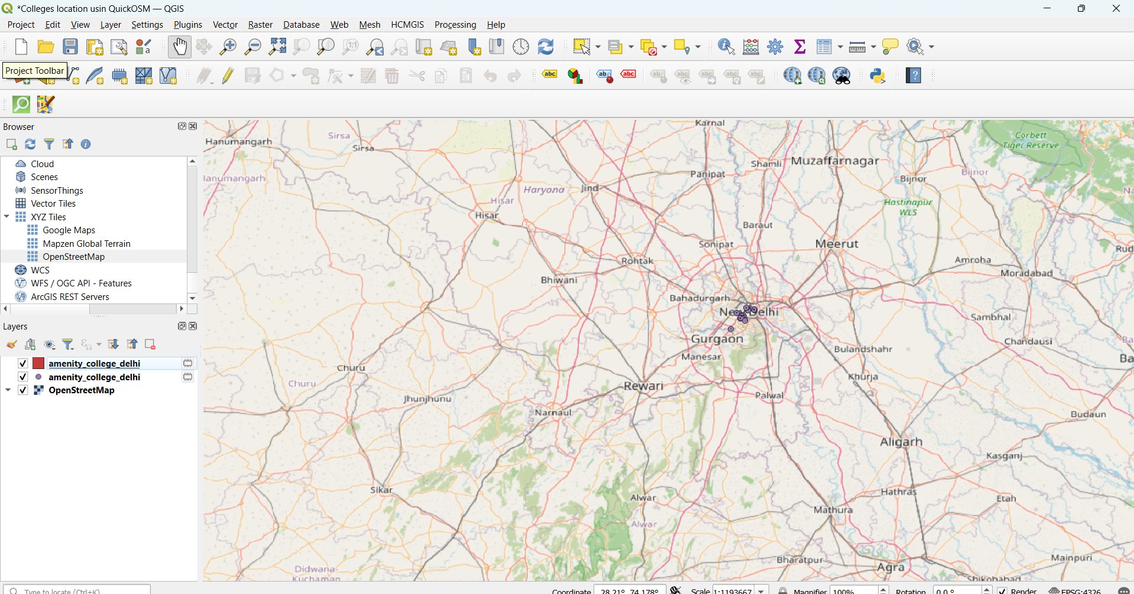

Slide 9


Vector Geoprocessing Tools
Clip
Buffer
Merge
Dissolve
Acts as a cookie cutter. Extracts features from one layer based strictly on the boundaries of an overlapping layer.
Creates a defined protective distance zone (polygon) around a point, line, or existing polygon feature.
Combines multiple separate, distinct vector layers into one single, unified layer for easier management.
Merges internal boundaries that share a common attribute to create a single, continuous outer boundary.

Slide 10
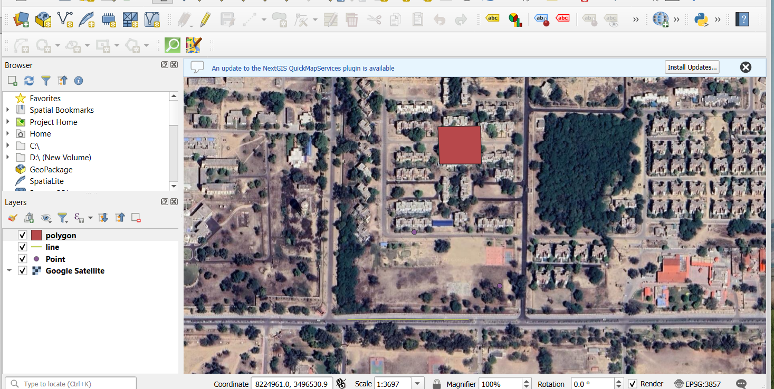

Slide 11
Manual Data Creation: Digitization
4. Populate Data
2. Toggle Edit
Open the Attribute Table to log specific names and values for the newly drawn shapes.
Enable editing mode by clicking the Pencil icon in the Layers panel.
1. Create Layer
3. Trace Features
Generate a New Shapefile Layer, specifying the geometry type (Point, Line, or Polygon).
Use the add feature tool to manually trace shapes over a high-resolution basemap.

Slide 12
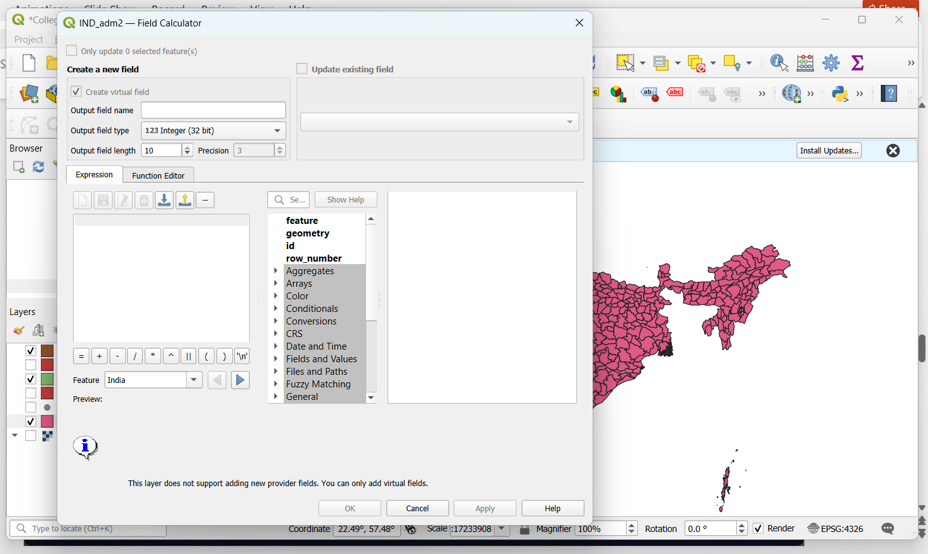

Slide 13
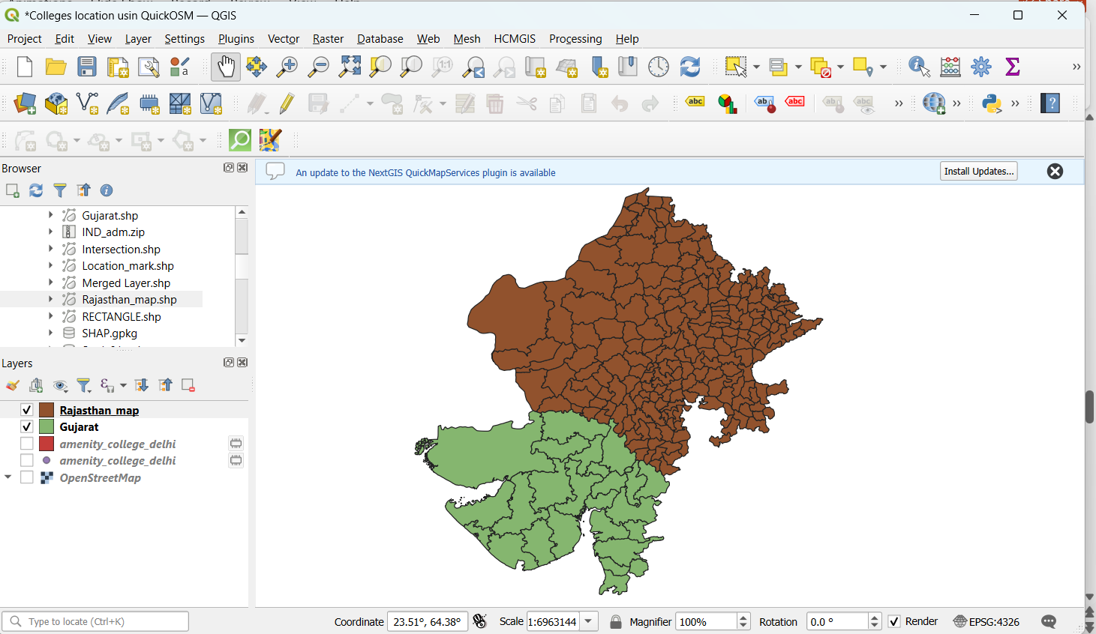

Slide 14
Working with Raster Data & DEMs
Elevation Models
Raster Extraction
Terrain Analysis
A Digital Elevation Model (DEM) is a raster where every single pixel stores height data above sea level.
Use the 'Clip Raster by Mask Layer' tool to isolate continuous raster data to a specific, defined vector boundary.
Utilize raw DEMs to automatically calculate and visualize Slope, Aspect, Hillshade, and topographic Contours.

Slide 15
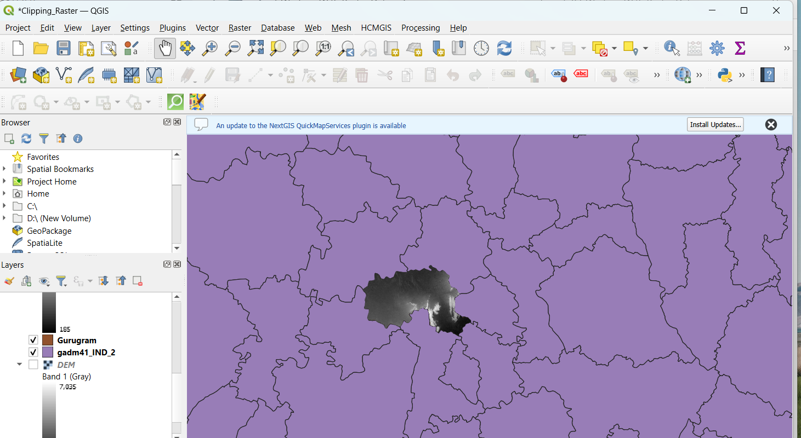

Slide 16
Aligning Historical Data: Georeferencing
4. Transform
2. Add GCPs
Run the process to mathematically warp and pin the image accurately over the spatial coordinate system.
Plot Ground Control Points matching distinct landmarks on the image to the live map canvas.
1. Load Raster
3. Configure
Import an unreferenced, static image (like a scanned map) into the Georeferencer tool.
Open Transformation Settings, set to Linear transformation and Nearest Neighbour resampling.

Slide 17
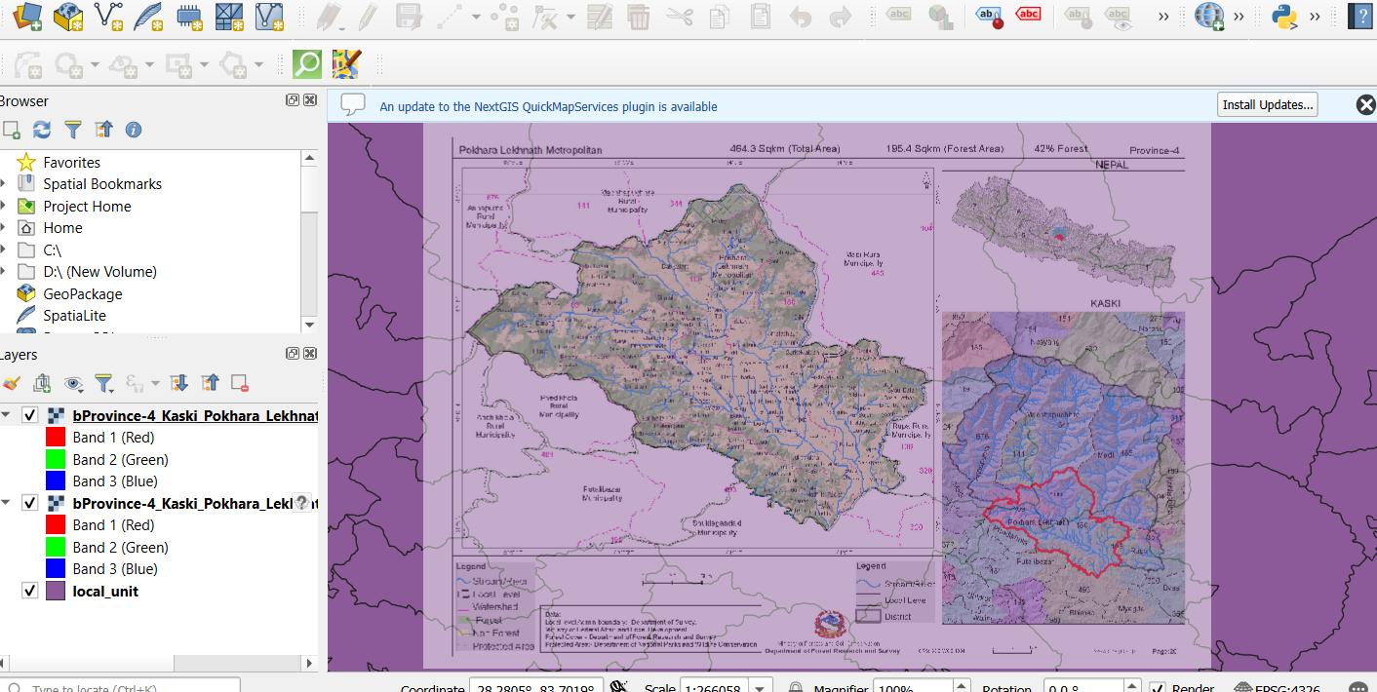

Slide 18
Final Map Production: Print Layout
Purpose of the Composer Translating raw GIS data layers into professional, readable cartographic products for sharing.
Locking Views After drawing a map box, locking layers freezes the view, allowing you to add separate inset maps securely.
Cartographic Elements Easily add dynamic Legends, Scale Bars, and North Arrows (ensuring the arrow uses EPSG:4326 CRS).
Exporting Generate the final composed layout as a high-resolution Image or a scalable PDF.

